Slide 1
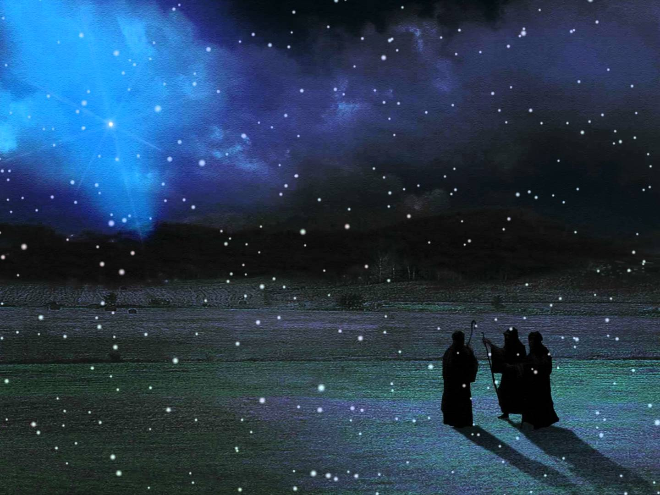

Slide 2
求主降靈雨
Showers of Blessing

Slide 3
1. 主賜聖靈好像下雨，
Chu su seng-leng chhin-chhiu^{n} loh-ho,
灌沃心靈的田埔， koan-ak sim-leng e chhan-po,
There shall be showers of blessing:
This is the promise of love;

Slide 4
當先認罪求主赦免， tioh seng jin-choe kiu Chu sia-bian,
才會得着這恩典。 chiah oe tit-tioh che un-tian.
There shall be seasons refreshing,
Sent from the Savior above

Slide 5
(和)
求主降靈雨，
Kiu Chu kang leng-u,
我心欣慕大靈雨， goa sim him- bo toa leng-u,
Showers of blessing,
Showers of blessing we need

Slide 6
雖曾領受這恩賜， sui bat nia- siu che un- su,
現在欲得更豐富。
Hian-chai ai-tit khah hong-hu.
Mercy drops round us are falling,
But for the showers we plead.

Slide 7
2. 主賜聖靈好像下雨，
Chu su seng-leng chhin-chhiu^{n} loh-ho,
心田乾燥大欣慕，
Sim- tian ta- so toa him- bo,
There shall be showers of blessing:
Precious reviving again;

Slide 8
若將身心全獻給主， na chiong sin sim choan hian ho Chu,
就能得着大恩賜。
Chiu oe tit- tioh toa un- su.
Over the hills and the valleys,
Sound of abundance of rain.

Slide 9
(和)
求主降靈雨，
Kiu Chu kang leng-u,
我心欣慕大靈雨， goa sim him- bo toa leng-u,
Showers of blessing,
Showers of blessing we need

Slide 10
雖曾領受這恩賜， sui bat nia- siu che un- su,
現在欲得更豐富。 hian-chai ai-tit khah hong-hu.
Mercy drops round us are falling,
But for the showers we plead.

Slide 11
3. 主賜聖靈好像下雨，
Chu su seng-leng chhin-chhiu^{n} loh-ho,
將心田托主看顧，
Chiong sim-tian thok Chu khoa^{n}-ko,
There shall be showers of blessing:
Send them upon us, O Lord:

Slide 12
切願靈雨滋潤土地， chhiat goan leng-u chu-lun tho-toe,
能結果子百倍多。
Oe kiat ke- chi pah- pe choe.
Grant to us now a refreshing,
Come, and now honor Thy word.

Slide 13
(和)
求主降靈雨，
Kiu Chu kang leng-u,
我心欣慕大靈雨， goa sim him- bo toa leng-u,
Showers of blessing,
Showers of blessing we need

Slide 14
雖曾領受這恩賜， sui bat nia- siu che un- su,
現在欲得更豐富。 hian-chai ai-tit khah hong-hu.
Mercy drops round us are falling,
But for the showers we plead.

